Slide 1


Introduction to R and RStudio
Fondren Library
Digital Scholarship Services

Slide 2
WHAT IS R?
Free, open-source
Data handling and storage
Programming language
Huge number of free packages give extended modeling, visualization, manipulation, and more capabilities

Slide 3
WHAT IS RSTUDIO?
Open-source, but not entirely free
Graphical user interface providing easy access to R
Not officially affiliated with R
Provides amazing cheat sheets!

Slide 4

THE RICE CONNECTION
Hadley Wickham
former Rice professor
Chief Scientist at Rstudio
Originator of the tidyverse
Author of “R for Data Science”

Slide 5
THE RSTUDIO INTERFACE
A walkthrough of important features

Slide 6
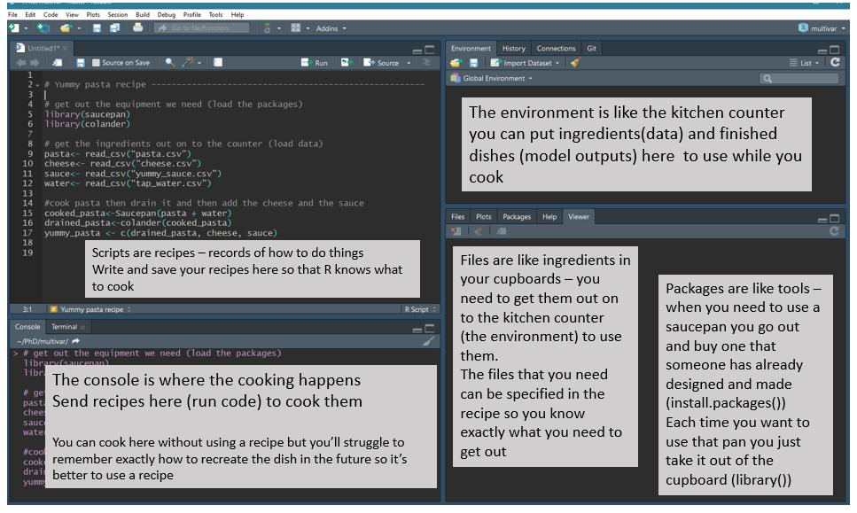

Slide 7
RSTUDIO INTERFACE

Slide 8
SIMPLE OPERATIONS
Arithmetic, assignment, matrix multiplication, converting between types

Slide 9
ARITHMETIC AND BASIC MATH
Addition: + (5 + 3)
Subtraction: - (5 - 3). Also, negation with - (-3)
Multiplication: * (5 * 3)
Division: / (5 / 3)
Power: ** or ^ (5**3, 5^3)
Square Root: sqrt function (sqrt(5))

Slide 10
ASSIGNMENT
Naming a value for future use
Value can change!
Variable names: must start with a letter, and then only letters, numbers, periods, and underscores
value <- 5, my.name <- “hello”, COOL_VALUE <-3 + 5i
NOT 1value <- 3, my-name <- 3, mass% <- 42

Slide 11
TYPE CONVERSION
as.(TYPE) functions
Example: as.integer(3.3)
Integer conversion always rounds down!
Especially useful for converting between various numeric types

Slide 12
DATA TYPES
Scalars, lists, arrays, matrices, factors, data frames, and vectors

Slide 13
SCALARS
One value
Types:
Character: ‘a’
Numeric (decimal)
Integer
Logical: TRUE or FALSE
Complex
Special missing value: NA

Slide 14
ATOMIC VECTORS
Fixed-length list of values of all the same type
Created with the c() function (concatenate)
Examples: c(1, 2, 3), c(0.4, 0.5), c(“hello”, “hi”). NOT c(1, “hello”)!
Access by subscript. If a is a vector, a[1] returns the 1st element.
Ranges: 1:14

Slide 15
LISTS
Variable list of values of any type
Created with the list() function
Examples: list(1, 2, 3), c(0.4, 0.5), c(“hello”, “hi”), list(1, “hello”)
Can always access by subscript. If a is a list, a[[1]] returns the 1st element
Also, can access by giving custom names to values!
ages <- list(16, 17); names(ages) <- c(“steve”, “tony”)
ages$steve

Slide 16
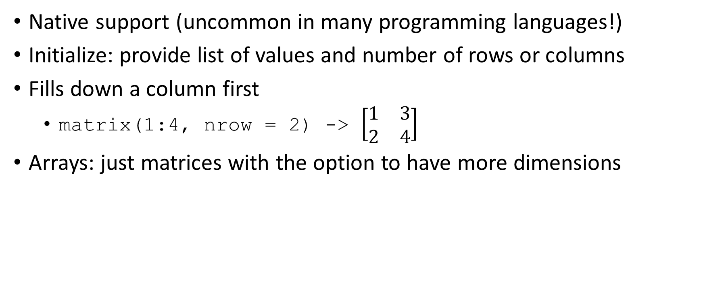
MATRICES
Native support (uncommon in many programming languages!)
Initialize: provide list of values and number of rows or columns
Fills down a column first
matrix(1:4, nrow = 2) -> $\left[\begin{matrix}1 & 3 \\ 2 & 4\end{matrix}\right]$
Arrays: just matrices with the option to have more dimensions

Slide 17
ACCESSING MATRICES
Given matrix mat
Access one value:
mat[3,4]: element in 3rd row, 4th column
Access a column:
mat[,3 ]: 3rd column
Access a row:
mat[3,]: 3rd row
Access a range of rows or columns:
mat[1:2, 3:5]
First 2 rows, columns 3 to 5
Can save to these as well using assignment operator
If using row or column, convert to matrix first!

Slide 18
MATRIX MULTIPLICATION
Uses %*% (don’t use *!)
Requires conformable dimensions
Number of columns in first matrix = number of rows in second matrix
Extremely fast!
Optimized libraries

Slide 19
FACTORS
Categorical data
Only a few possible values
Example: US States
Create a factor with factor(c(...), levels=c(...))
First argument: vector
Levels: all possible values
If not provided, factor will assume you have provided all possibilities
e.g. factor(c(“Grad Student”, “Grad Student”, “Staff”), levels=c(“Grad Student”, “Staff”, “Faculty”))

Slide 20
DATA FRAME
The quintessential R data type
Extremely flexible and powerful
Structure
Column: a variable
Row: an observation
Give data as columns.
Example: data.frame(name=c(“John”, “Molly”), age=c(15,17))
John is 15, Molly is 17

Slide 21
ACCESSING DATA FRAMES
Extract a column:
df$ages
Extract a row:
df[,1]
Note: this is the same syntax as matrices!
Can also pass ranges of rows similarly

Slide 22
EXAMINING DATA FRAMES
Data frames are frequently huge. Use the following commands to take a look without printing out thousands of lines:
head(df)
Take a look at the first few entries
tail(df)
Take a look at the last few entries
colnames(df)
Take a look at the available variables

Slide 23
A NOTE ABOUT FUNCTIONS
Two types of arguments/parameters to functions:
Positional: mean(data)
Keyword: mean(data, NA.RM=TRUE)
Functions in R often take optional keyword parameters. Check a function out in R with ?function or help(function) and see if there are any additional arguments that might help make your life easier!

Slide 24
READING AND WRITING DATA
Excel, Comma-Separated and Tab-Separated Values, and more!

Slide 25
COMMON FILE FORMATS
Comma/Tab Separated Values: (.csv, .tsv)
Example:
name,age,occupation (first line: header)
tony,23,banker (all other lines: observations)
Excel files (.xlsx, .xls*)
JSON (.json)
{“name”: “Tony”, “age”: 23, “occupation:” “banker”}
XML (.xml)
<person> <name>Tony</name> <age>23</age> <occupation>banker</occupation> </person>

Slide 26
READING FILE FORMATS
Comma/Tab Separated Values: (.csv, .tsv)
Read.csv
Excel files (.xlsx, .xls*)
JSON (.json)
Example
XML (.xml)
Example

Slide 27
WRITING FILE FORMATS
Comma/Tab Separated Values: (.csv, .tsv)
Write.csv
Excel files (.xlsx, .xls*)
JSON (.json)
Example
XML (.xml)
Example

Slide 28
A WORD OF WARNING ON FACTORS
R is quick to assume strings you pass in data frames are factors
Example: df <- data.frame(name=c(“John”, “Molly”), age=c(15,17))
Name is a factor!
Does this make sense?
If this a problem (which it often is), change the type of the column with as.character().
df$name <- as.character(df$name)

Slide 29
DATA MANIPULATION
Subsetting and filtering

Slide 30
MAKING NEW COLUMNS FROM OLD
Arithmetic operations can apply to the whole column with no extra work on your part!
Very useful for converting between units
df$length.cm <- df$length.in * 2.54

Slide 31
LOGICAL OPERATORS
Test for Equality: == (a == b)
Test for Inequality: != (a != b)
Test for Less than: < (a < b)
Test for Less than or equal to: <= (a <= b)
Test for Greater than: > (a > b)
Test for Greater than or equal to: >= (a > b)

Slide 32
FILTERING / SUBSETTING
By Row:
df[3-7] selects the 3rd through 7th row
By Column:
subset(df, age > 10) takes all observations where age is greater than 10. note that age is a column in the data frame, and you don’t need to type df$age!

Slide 33
CLEANING
Use subsetting to delete unusable rows
Common use case: remove rows which have a NA (erroneous results)
df <- subset(df, !is.na(value))
value != NA does not work

Slide 34
SUMMARY FUNCTIONS
Mean: mean(data)
Median: median(data)
Range: range(data). Gives lower and upper bounds
Standard Deviation: sd(data)
The na.rm parameter: ignore any missing values. Summaries don’t work otherwise!
Example: median(data, na.rm = TRUE)

Slide 35
THE APPLY FAMILY
sapply(column, function)
Apply function to every element of a vector, and use simplest type of output (e.g. vector if all elements of list are the same)
Can pass a function as an argument to another function!
Ex: sapply(names, tolower)
tapply(column, groups, function)
Apply a summary function to a column for each of the groups
Ex: Say gpadf is a dataframe of students. tapply(gpadf$gpa, gpadf$major, mean) will give you the average GPA for each major!

Slide 36
VISUALIZATION
Scatterplots, boxplots, and histograms

Slide 37
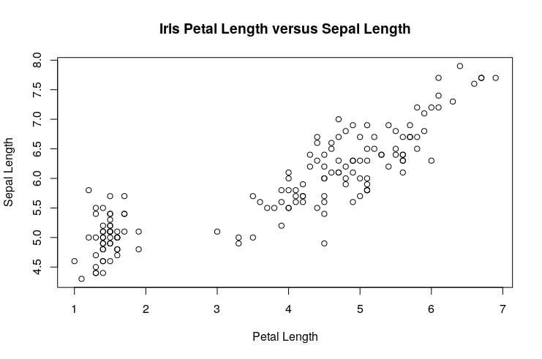
SCATTERPLOTS
plot(x_axis, y_axis) for vectors x_axis and y_axis
plot(dataframe) if the data has two columns, will plot the first variable on the x-axis
Use xlab=“x-axis title”, ylab=“y-axis title”, and main=“Main Title” to add titles!

Slide 38
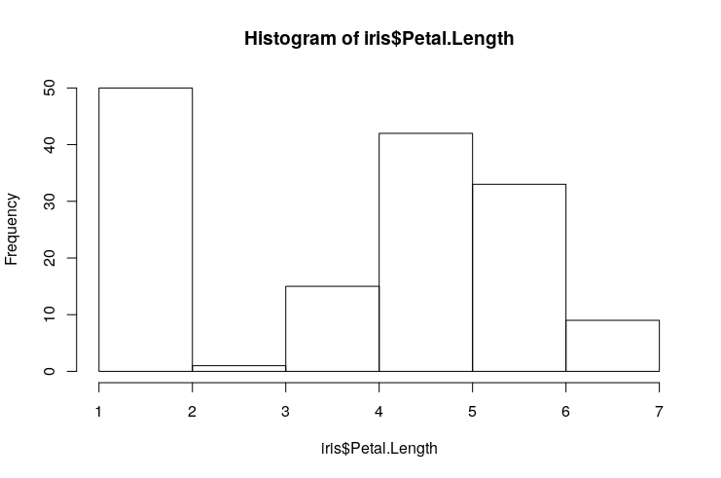
HISTOGRAMS
hist(values)
Plots how many values fit into each of a number of equal-sized sections
Mildly interesting: you can pass breaks=“scott” to employ an algorithm to automatically determine a bin size. This is named in honor of a Rice professor’s work!

Slide 39
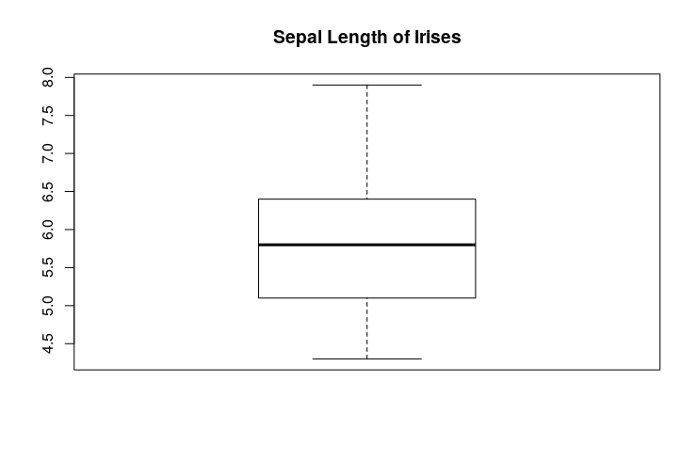
BOXPLOTS
boxplot(column)
Similar visualization to a histogram
Shows the minimum, 25% percentile, median, 75% percentile, and maximum
Also will detect and show outliers

Slide 40
MODELING
Simple Linear Regression and plotting

Slide 41
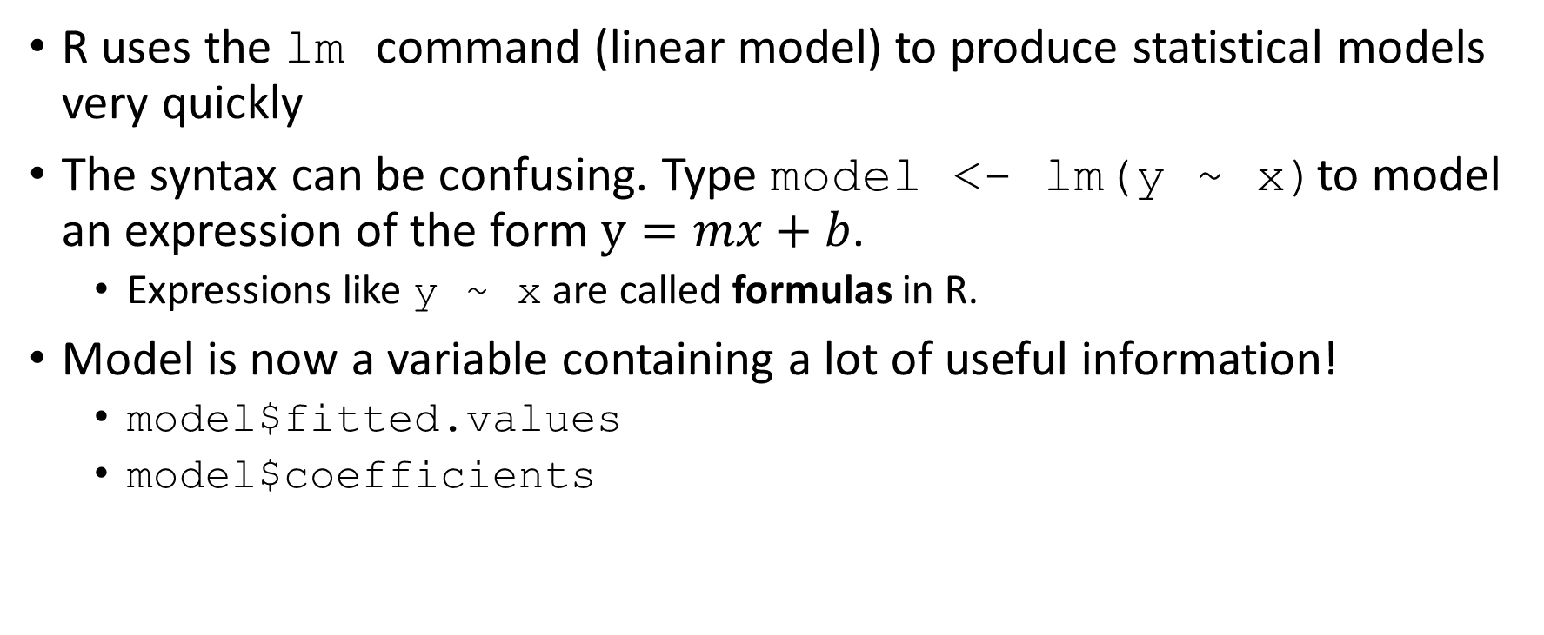
LINEAR MODELING
R uses the lm command (linear model) to produce statistical models very quickly
The syntax can be confusing. Type model <- lm(y ~ x)to model an expression of the form $y=mx+b$.
Expressions like y ~ x are called formulas in R.
Model is now a variable containing a lot of useful information!
model$fitted.values
model$coefficients

Slide 42
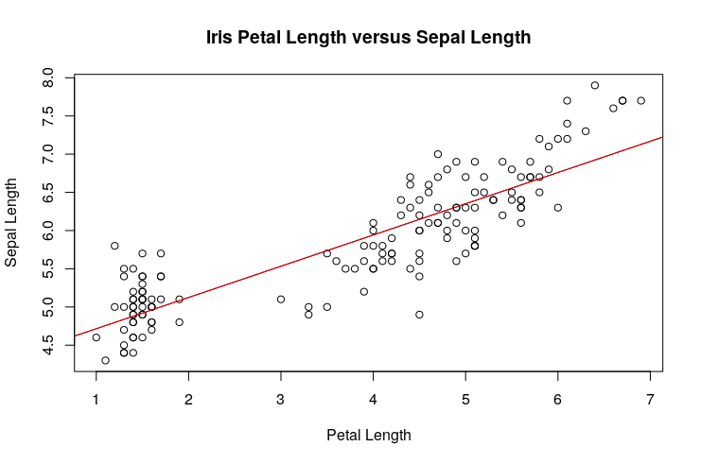
VISUALIZING LINEAR MODELS
Use abline(lm) to add a line to a graph that already exists
lm is a linear model object
Use col=“red” (or any other common color name) to change the color of the line and make it easier to see!

Slide 43
ACKNOWLEDGMENTS
The R logo (https://www.r-project.org/logo/) is used under the terms of the Creative Commons Attribution-ShareAlike 4.0 International license.

